Slide 1

Clockwise your Investment
GROUP 6:
Ziwen Chen
Shasha Li
Andy He
Minglu Li

Slide 2
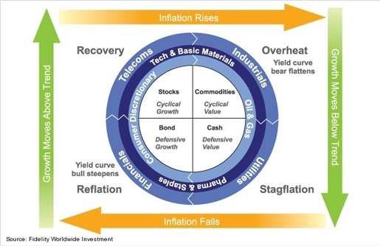
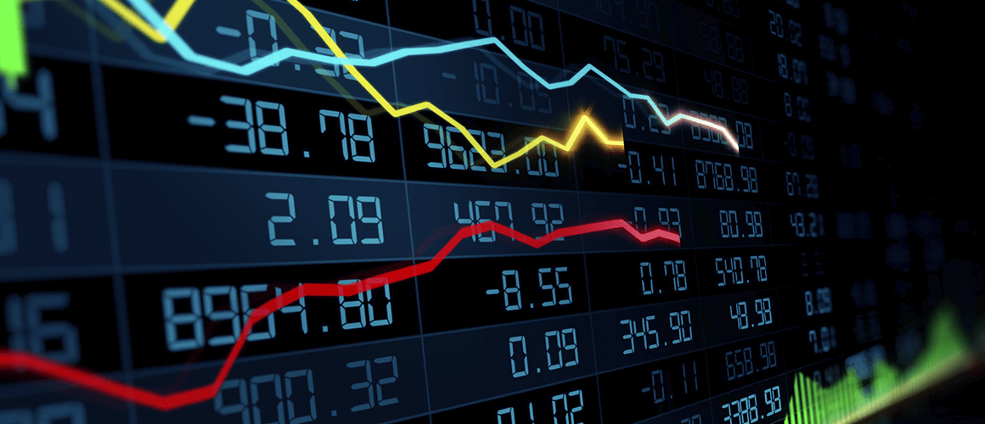
Idea of the Project
Merrill Lynch’s Investment Clock Theory:
Timing investment with economic factors
GDP and Inflation as key indicators
4 economic stages
Top and worst performers among assets
Notes:
Hook
Asset manager, equity researcher, financial advisor -> Fundamental
Traders, hedge fund managers, algo trading developers -> Technical
Types: Momentum, Trend, Volatility…..

Slide 3
Purpose of the Project
Apply the investment clock theory to real life:
Find the top performers and worst performers among 12 underlying assets for each of 4 economic stages during the most recent 2 business cycles
12 underlying assets: 11 equity sector ETFs and 1 Bond ETF
The most recent 2 business cycles: 2004 - 2021
Long top performers and Short worst performers during each economic stage for optimizing the investment return
Our project is a prototype for further application and research, such as apply into different theories and can be replaced by other indicators/assets
Notes:
11 sector ETFs from Ishares , and AGG

Slide 4

Part 1: Data Preparation
Imported monthly data of US GDP and Inflation from March 1st, 2004 to November 1st, 2021(FRED Economic Data)
Imported 12 underlying assets (11 ETFs and 1 bond) for the same time period and frequency through Yahoo Finance API
Imported SPY as a benchmark for the same time period
Notes:
No data No Project

Slide 5
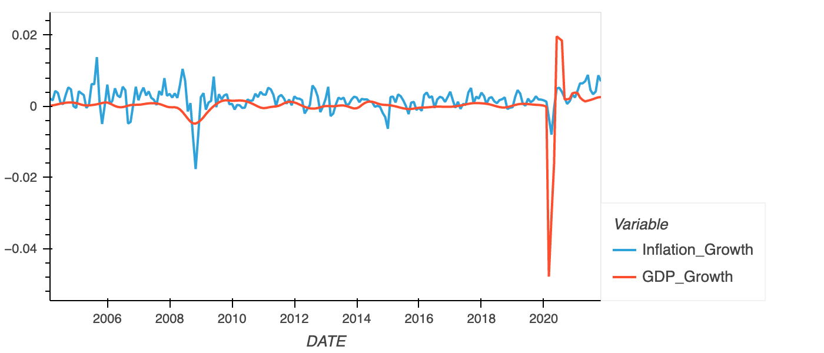
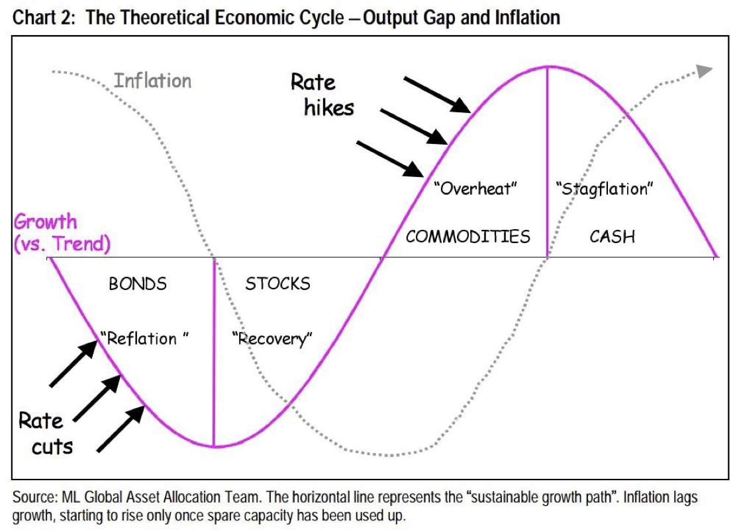
GDP and Inflation
We calculated the speeds of GDP growth rate and Inflation growth rate respectively. In this way, we can categorize the 4 economic stages according to Merrill Lynch’s Investment Clock Theory.

Slide 6
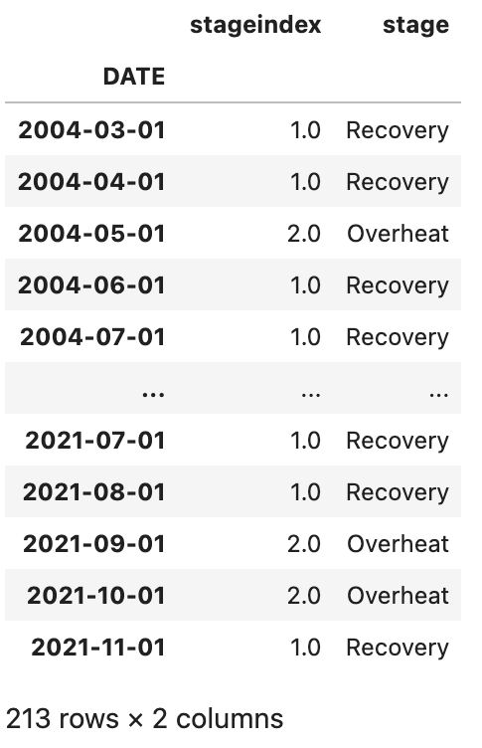
GDP and Inflation
When speed of GDP growth < 0, and speed of inflation growth < 0
Reflation Stage (Stage 0)
When speed of GDP growth > 0, and speed of inflation growth < 0
Recovery Stage (Stage 1)
When speed of GDP growth > 0, and speed of inflation growth > 0
Overheat Stage (Stage 2)
When speed of GDP growth < 0, and speed of inflation growth > 0
Stagflation Stage (Stage 3)

Slide 7
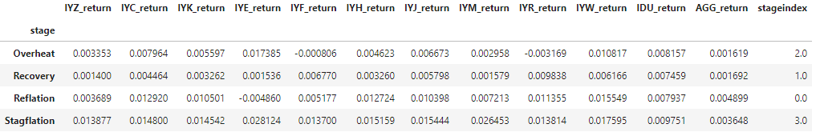
12 Underlying Assets
Communication | IYZ
Consumer Discretionary | IYC
Consumer Staples | IYK
Energy | IYE
Financials | IYF
HealthCare | IYH
Industrials | IYJ
Materials | IYM
Real Estate | IYR
Technology | IYW
Utility | IDU
Bond | AGG
Calculate daily return of each underlying assets
Calculate the mean return of each ETF in each stage in order to find the top performers and worst performers in each economic stages

Slide 8
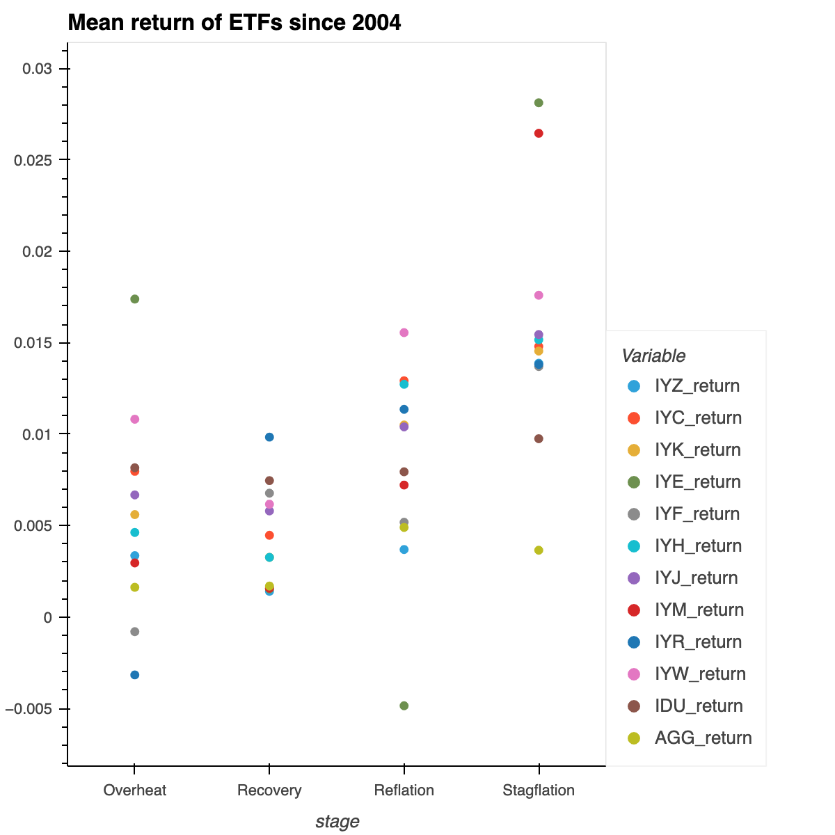
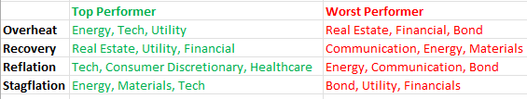
12 Underlying Assets
We picked 3 top performers and 3 worst performers from each economic stage based on the most recent 2 business cycles.
The results doesn’t match exactly with the Merrill Lynch’s Investment Clock Theory. (Ex: Bond in Reflation)

Slide 9
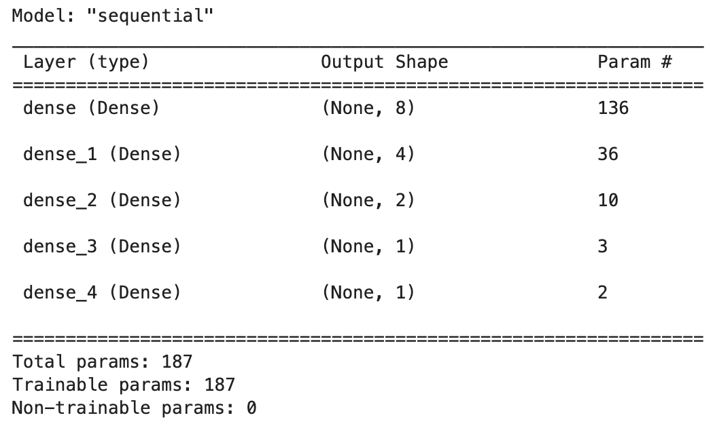
Part 2: Neural Network
Solution:
Encode 4 stages as indicators and create categorical variables to make indicators more “significant” to the signal and train scaled Xs
Activation function change to “elu” for 4 hidden layers to produce negative output
Activation function change to “linear” for the output layer
Loss function change to “mse”
Metrics change to “mse”
Use training data to predict
Use testing data to predict

Slide 10
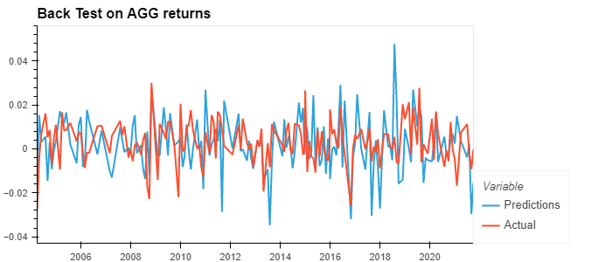
Neural Network
eg. AGG

Slide 11
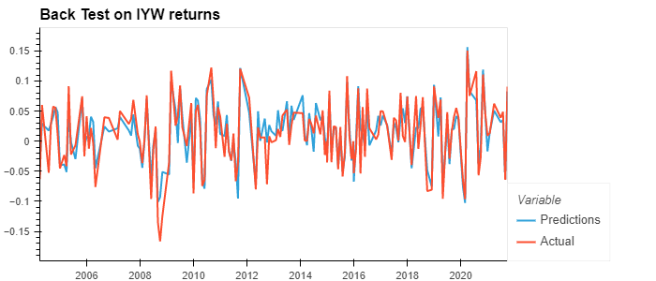
Neural Network
eg. IYW

Slide 12
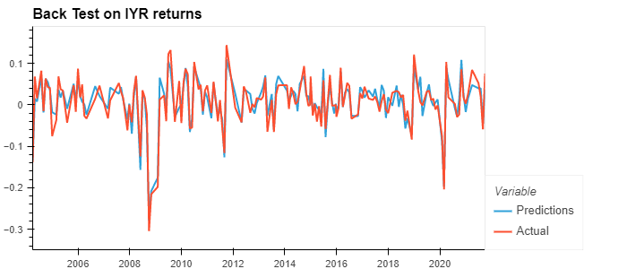
Neural Network
eg. IYR

Slide 13
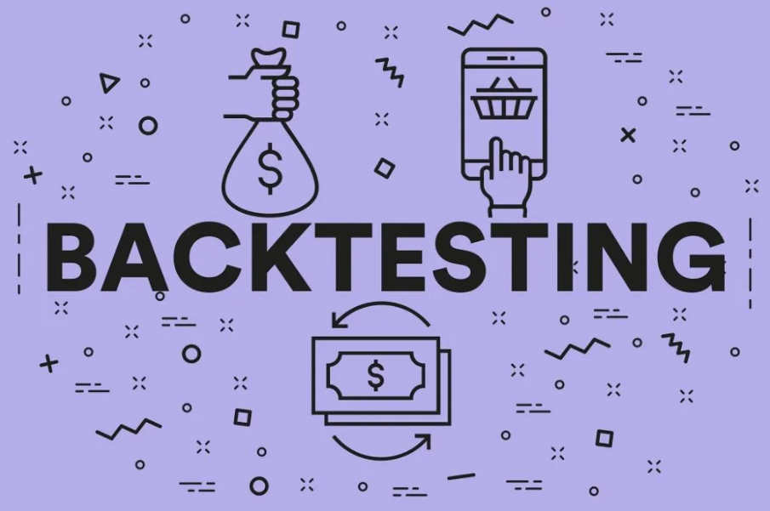
Part 3: Backtesting Performance
Long 3 top performers and Short 3 worst performers (a total of 6 ETFs) during each economic stage
Give each ETF 16% weights when calculating returns for each stage, and leave 4% for cash reserve.
Suppose 0.1% commission fee
Import SPY as a benchmark comparison

Slide 14
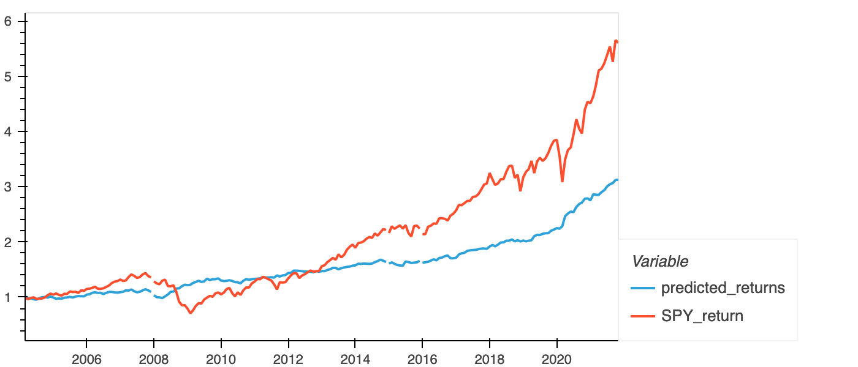
Results
Our trading strategy generally underperformed than SPY, but outperformed SPY during 2008-2012 financial crisis
During the market crisis in the early 2020 triggered by COVID-19, our strategic return grew steadily while SPY dropped rapidly
In general, our strategy is arguably more stable than SPY and could be an effective solution to the major market crisis

Slide 15
Part 4: Streamlit Dashboard
Live Demonstration!

Slide 16

Summary
We applied the investment clock theory driven by economic indicators into real-world investing, using neural network to reinforce its credibility and backtest its profitability
Our result demonstrates that:
The top and worst performers in each economic stage are not necessarily the same as the theory suggests in the recent 2 decades
Our strategy yields a more stable return than the SPY benchmark and could be an investment solution during the market crisis

Slide 17

Next Steps
We have to rebalance the portfolio each month, which however, causes inevitably high commission fee. We’d like to hold the assets and rebalance the portfolio until economic stage changes, but we haven’t found a way to deploy this idea yet
We ignored the fact that there might be an early/late period in each economic stage, during which the assets might perform differently. We can dig deeper to further analyze this application
We backtest the performance of the theory because we find that SVC model is not applicable to our strategy. We are welcoming any potential applicable algo trading models
Other alternative assets, such as commodities/cryptos, can be applied into our model
Notes:
The Steamlit dashboard can also be optimized.

Slide 18

THANK YOU!
Notes:
Comment #1: Find the Sharpe and Beta of the portfolio

